Slide 1

Business Gap:
Impacting the efficiency, effectiveness & reliability of testing process
Proposal:
Use Generative-AI to create Test Data
Accelerates the process of Test Data creation and conditioning
Simple No-Code process can facilitate Business teams to generate test data and easily derive simulations & dry-runs
Use Cases:
Test Data Generation without using Code
Offer Campaign Simulation by Business team
Generative AI based IVR system
Enhanced Security
Real time feedback if the password is strong or weak, based on customer/employee profile
Team : Binary Visionaries
Aishwarya Alladi | AA50630
Jackson Comstock | JC29650
Gagan Sharma | GS55392

Slide 2
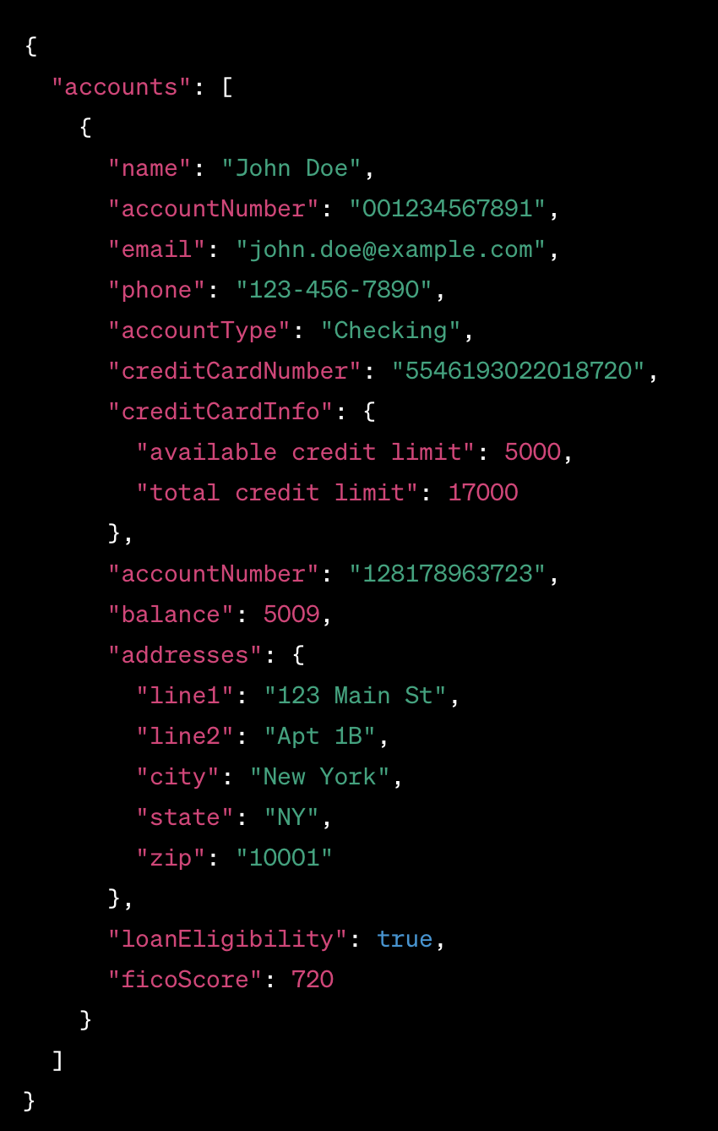
DEMO
Test Data un-availability:
Delayed development, testing & Release cycles
Reduced Test Coverage:
Leads to bad user experience, and in some cases Legal and reputational damage
Limited Scalability and Automation:
Limits the ability to adopt to CI/CD practices
Time consuming and Expensive:
Test data generation & conditioning is labor intensive
In some cases takes days or weeks to condition test accounts
UseCase-4
Sources
UseCase-3
Generating & Conditioning Test Data
Problem Statement
UseCase-2
Approach
UseCase-1

Slide 3

Sources
Leveraging OpenAI
Build applications without traditional programming
Increase scope of Automation
Dynamic Content and Data Creation
Roles and Behavior in OpenAI
Roles like System, User, Assistant etc. tailor the output of data creation
Behavior description guide the model's responses to ensure they align with the specific requirements
Maintains quality and relevance
Processes
Created a web application using HTML interface to take inputs and show results
Hosted a Python server using Flask, to interact with OpenAI apis (model : gpt-3.5-turbo-16k-0613)
Used JavaScript in the middle to Send and Receive Requests
Maintained conversational mode with OpenAI apis to keep the context
Based on multiple use cases, defined GPT mode roles and behavior on the go
DEMO
Problem Statement
OpenAI API
Roles & Behavior
UseCase-4
Approach
UseCase-3
UseCase-1
UseCase-2

Slide 4
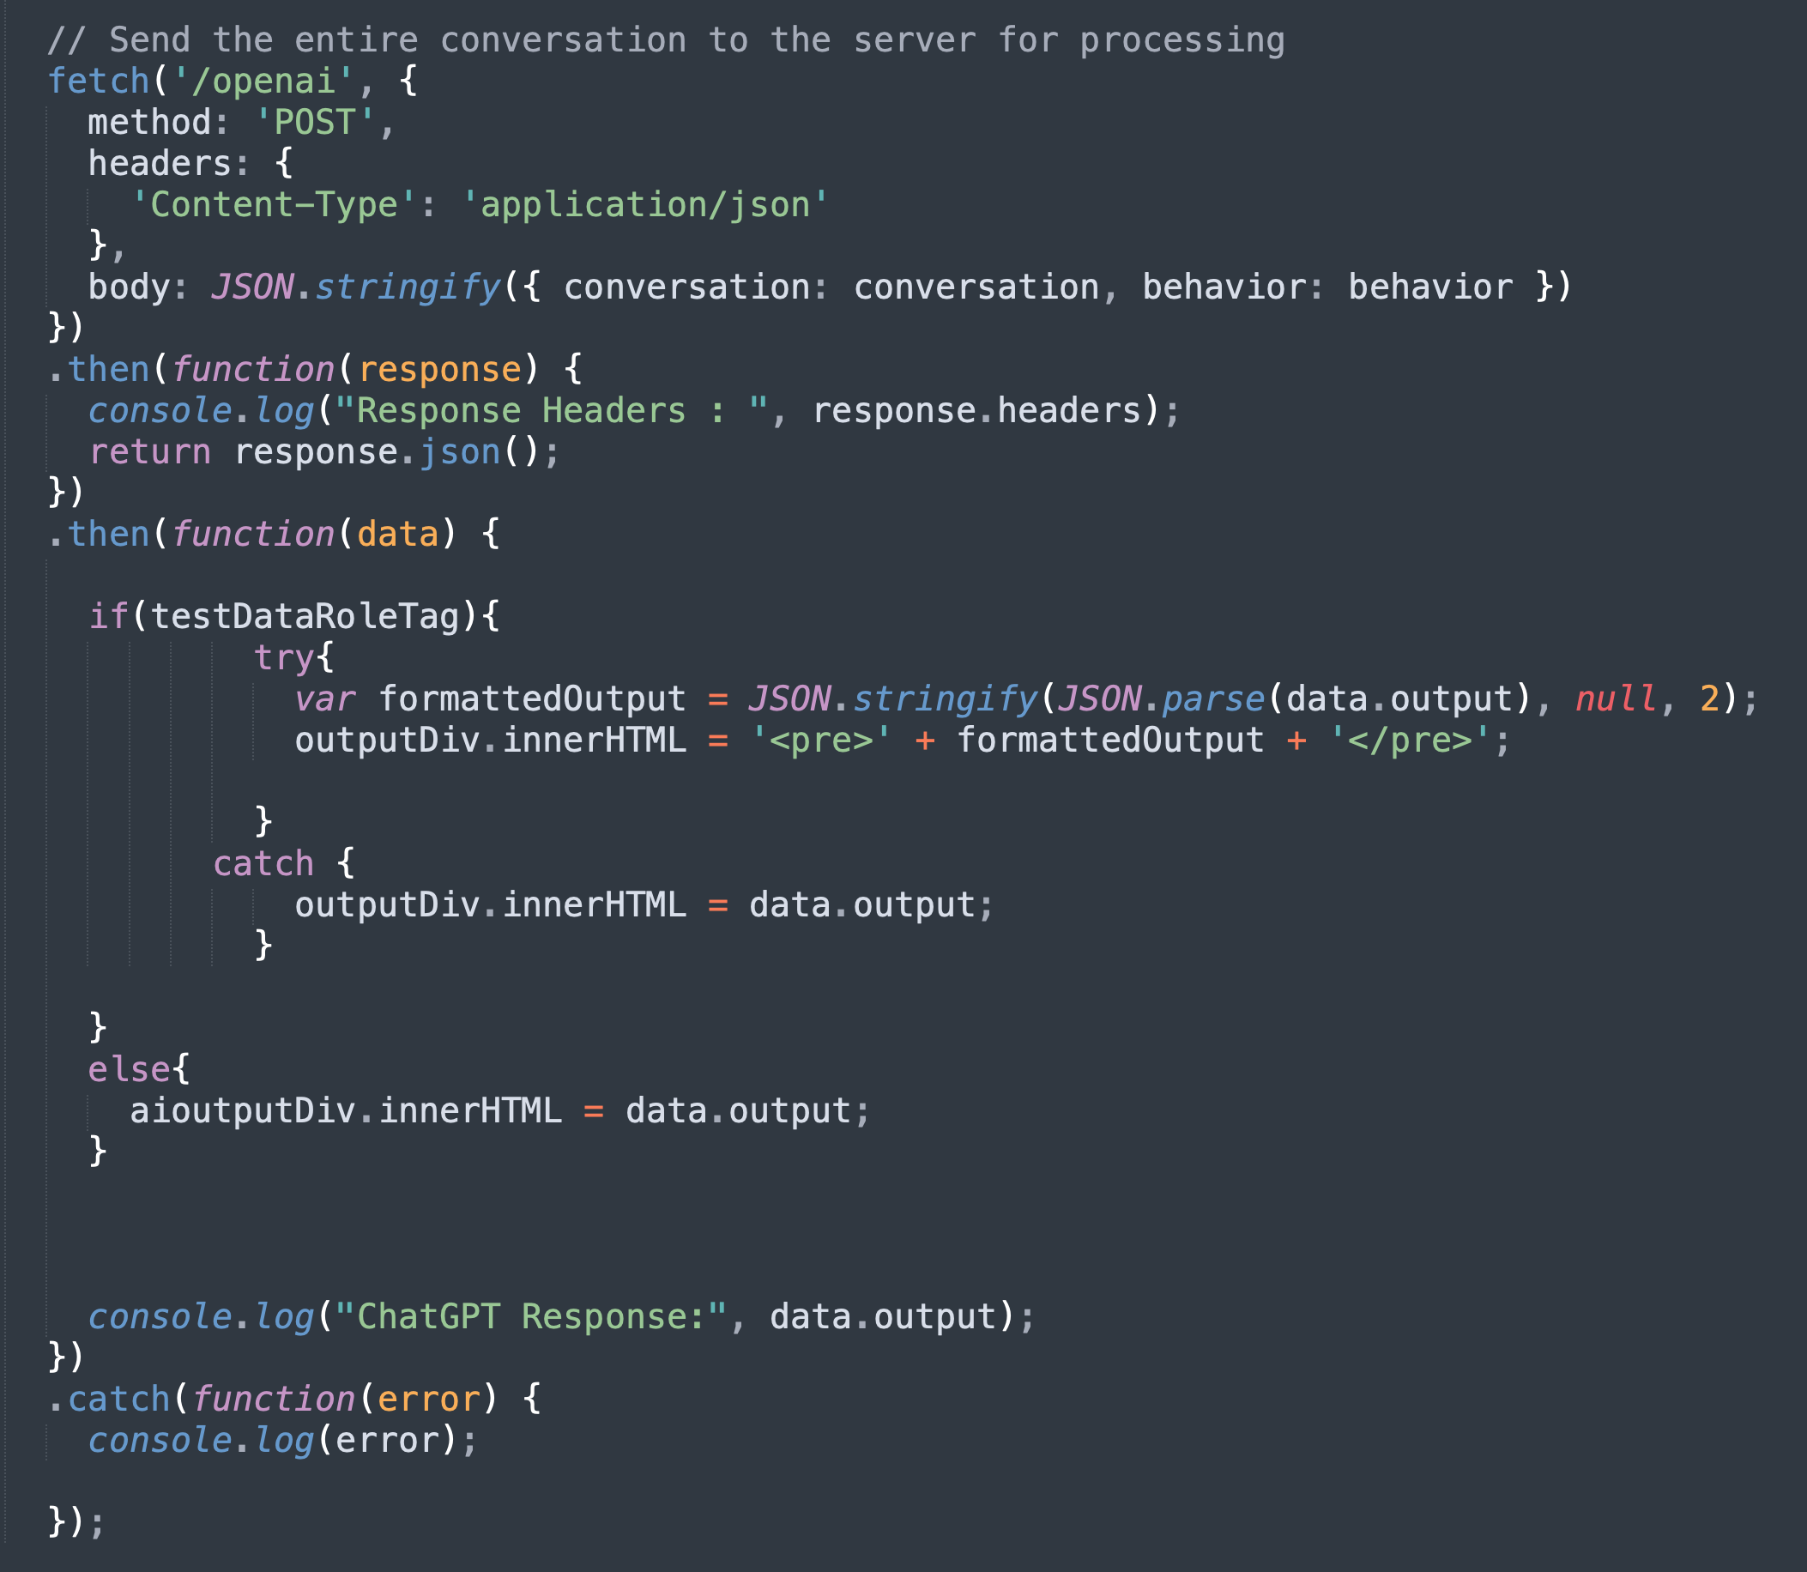
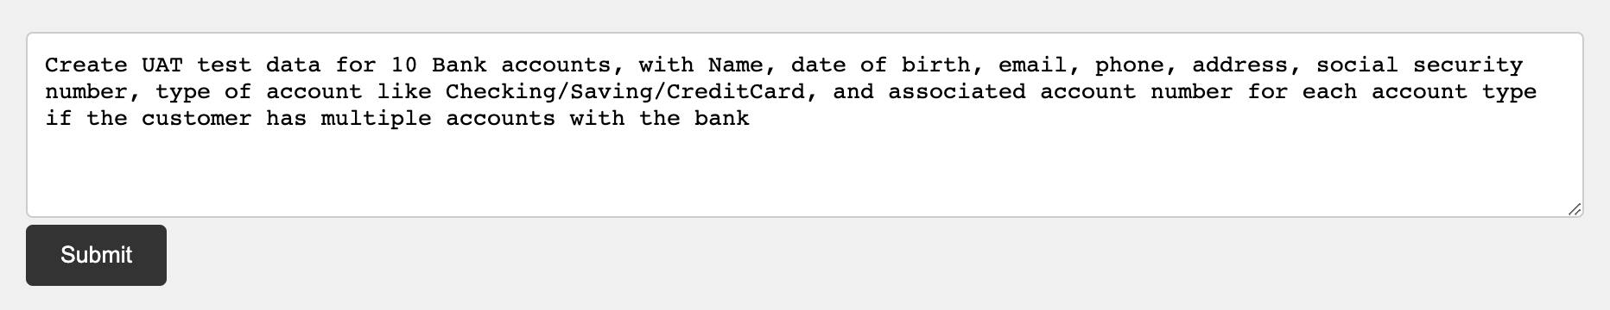
Problem Statement
Generative AI : Natural Language Processing to create Test Data
No Code required to create test data, after initial minimal setup
Automated Test Case generation using Natural Language commands
Data Augmentation on the go
Data formatting : JSON, CSV etc
Edge Case Testing
Roles and Behavior in OpenAI
Roles like System, User, Assistant etc. tailor the output of data creation
Behavior description guide the model's responses to ensure they align with the specific requirements
Maintains quality and Relevance
Sources
Approach
DEMO
Test Data Creation - OpenAI
UseCase-1
UseCase-4
UseCase-2
UseCase-3

Slide 5
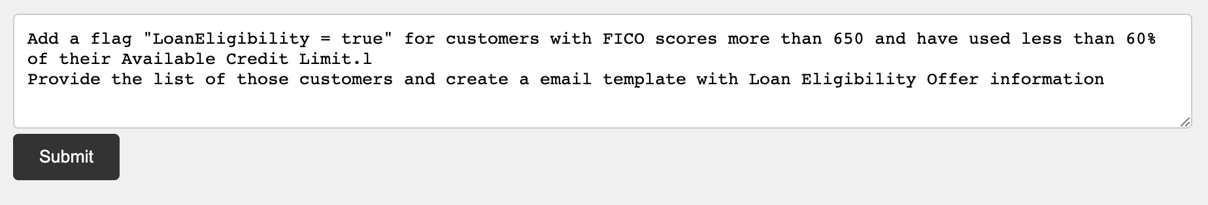
Approach
Generative AI : Natural Language Processing to create Test Data
No Code required to create test data, after initial minimal setup
Automated Test Case generation using Natural Language commands
Data Augmentation on the go
Data formatting : JSON, CSV etc
Edge Case Testing
Roles and Behavior in OpenAI
Roles like System, User, Assistant etc., tailor the output of data creation
Behavior description guide the model's responses to ensure they align with the specific requirements
Maintains quality and Relevance
Problem Statement
UseCase-1
Sources
Offer Campaign Simulation
UseCase-2
DEMO
UseCase-3
UseCase-4

Slide 6
UseCase-1
Generative AI : Natural Language Processing to create Test Data
No Code required to create test data, after initial minimal setup
Automated Test Case generation using Natural Language commands
Data Augmentation on the go
Data formatting : JSON, CSV etc
Edge Case Testing
Roles and Behavior in OpenAI
Roles like System, User, Assistant etc. tailor the output of data creation
Behavior description guide the model's responses to ensure they align with the specific requirements
Maintains quality and Relevance
Approach
UseCase-2
Problem Statement
Generative AI Based IVR
UseCase-3
Sources
UseCase-4
DEMO

Slide 7
UseCase-2
Generative AI : Natural Language Processing to create Test Data
No Code required to create test data, after initial minimal setup
Automated Test Case generation using Natural Language commands
Data Augmentation on the go
Data formatting : JSON, CSV etc
Edge Case Testing
Roles and Behavior in OpenAI
Roles like System, User, Assistant etc. tailor the output of data creation
Behavior description guide the model's responses to ensure they align with the specific requirements
Maintains quality and Relevance
UseCase-1
UseCase-3
Approach
Check Password Strength
UseCase-4
Problem Statement
DEMO
Sources

Slide 8
UseCase-3
UseCase-2
UseCase-4
UseCase-1
Demo
DEMO
Approach
Sources
Problem Statement

Slide 9
UseCase-4
Sources:
Link to GitHub code repo : https://github.com/gaganthesky/BinaryVisionariesHack
OpenAI Documentation : https://platform.openai.com/docs/libraries/python-library
Challenges
In-consistent behavior of GPT model
Parsing JSON if the response is not formatted correctly
Wish List
Accepting inputs using Voice
Maintains quality and Relevance
Show in real-time, count of tokens spent on each query, with a total count of Tokens used
response.headers.get('x-openai-usage’) didn’t work with current GPT model
UseCase-3
UseCase-5
UseCase-2
Sources
Sources
UseCase-1
Problem Statement
Approach

